Slide 1
US Political Beginnings
Basic Concepts of Government
Major English Documents
Types of English Colonies

Slide 2
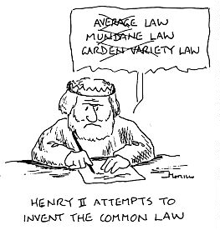
Remember
English colonies had political systems
English Common Law
Laws, Customs,
Practices, Institutions
Precedent

Slide 3
Basic Concepts
Ordered Govt
Orderly regulation of day to day activities
Seen in local govt
Examples
Sheriff, Coroner, Justice of the Peace, Grand Jury, Counties

Slide 4
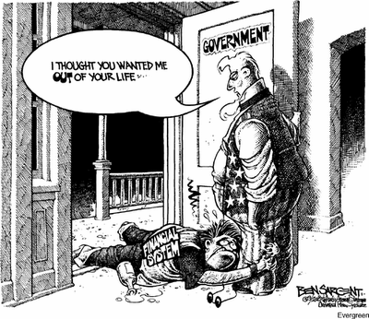
Basic Concepts
Limited Govt
Govt not all
powerful
Individuals had
rights
Had been
developing for
100s of years

Slide 5
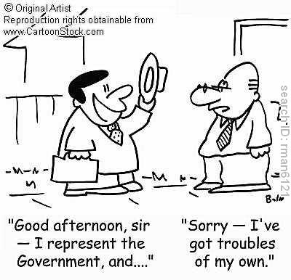
Basic Concepts
Representative Govt
Govt should serve will of the people
People should have a voice

Slide 6
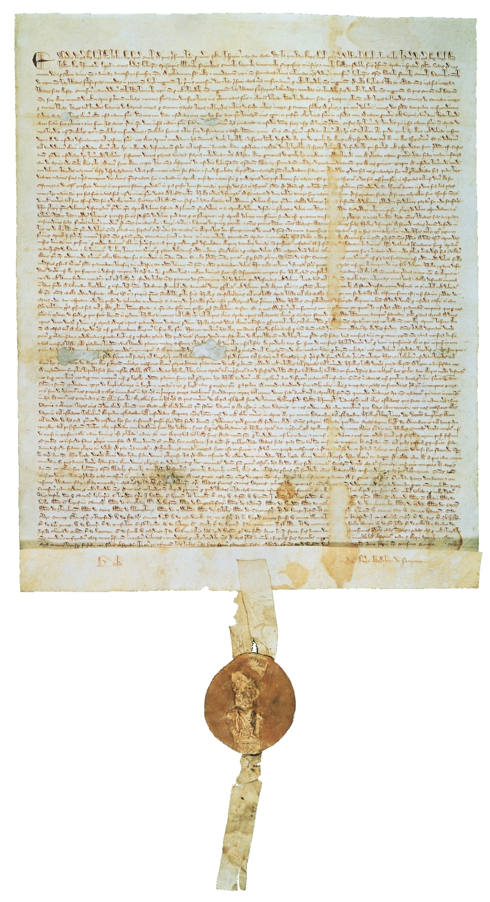
Major English Documents
Magna Carta 1215
King John taxed heavily
Nobles wanted to protect themselves
Ideas
Trial by jury
Due process of law
Protect life, liberty, property
Only for privileged
Eventually extended
Showed monarch not all powerful

Slide 7
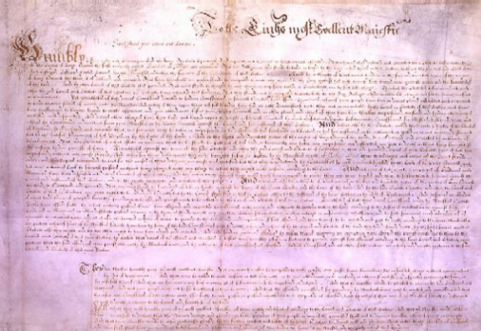
Major English Documents
The Petition of Right 1628
Limited kings power too
Said:
No random imprisonment
Limits on martial law
No quartering
No tax w/o Parl. consent
Challenged Divine Right of Kings

Slide 8
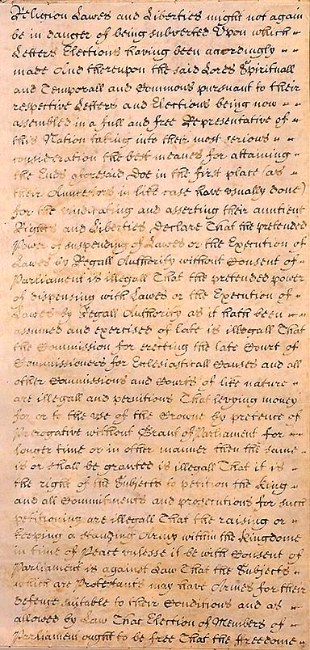
Major English Documents
The English Bill of Rights 1689
During Glorious Rev
Provisions
No army during peace
Free elections of Parl.
Couldn’t suspend laws
Couldn’t spend $ w/o Parl.
Couldn’t suspend Parl.
Regular people could petition King
Right to fair trial
No cruel and unusual punishment

Slide 9
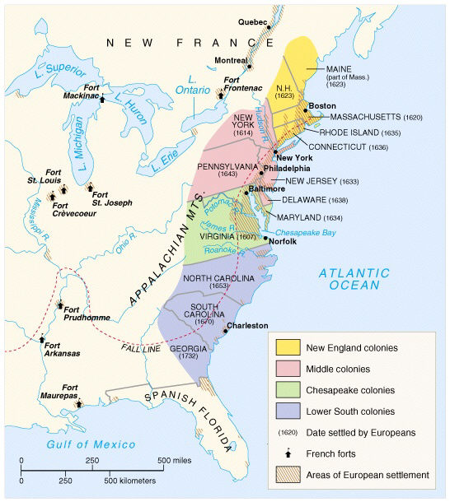
English Colonies
VA first 1607
Jamestown
VA Company
MA
Religious freedom
GA
Debtors
All established by charter
Written grant of authority by King

Slide 10
English Colonies
Royal Colonies
Direct control by crown
NH, MA, NY, NJ, VA, NC, SC, GA
King names governor
Had bicameral legislatures (2 houses)
Governor’s council upper
Lower elected by property owners
All laws approved by Gov.

Slide 11
English Colonies
Proprietary Colonies
Org. by someone King gave land to
MD, PA, DE
Governed by proprietor
Governor appointed by prop.
PA had unicameral leg (1 house)

Slide 12
English Colonies
Charter Colonies
Land given to colonists
CT, RI
Self-governing
Governors elected by white, male, land-owners
Progressive

