Slide 1
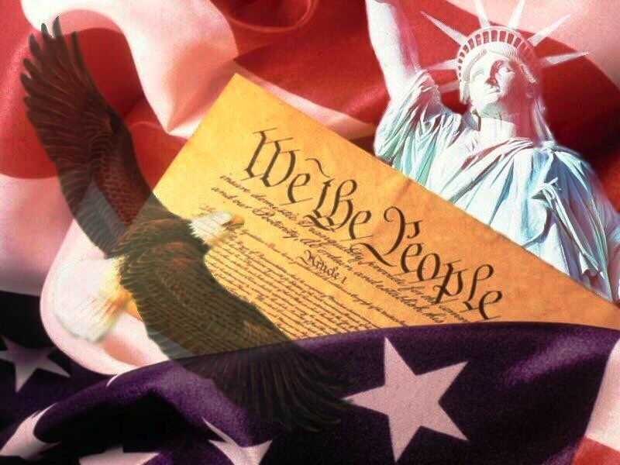
Ratifying the Constitution

Slide 2
What Next
Copies sent to states (1787)
Let them debate
Needed 9 of 13 to ratify
Better than 100% needed under Articles

Slide 3
Factions Emerge
Federalists
Favored ratification
James Madison and Alexander Hamilton
Stressed weaknesses of Articles
Anti-Federalists
Opposed ratification
Patrick Henry, John Hancock, Samuel Adams
Against powers of central govt, no bill of rights

Slide 4
The Nine
DE first
NH made it nine on June 21, 1788
But, NY and VA were not in
Very powerful states

Slide 5
VA’s Fight
Much debate
Washington and reluctant Jefferson played huge role
VA approved 4 days after NH

Slide 6
NY’s Fight
Much debate as well
Swung by The Federalist
85 essays
Written by Hamilton, Madison, and Jay
Published for ppl in newspapers
NY ratified

Slide 7
Inaugurating New Govt
Chose NY as temporary capital
Dates
1st Wed in Jan 1789
States chose electors
1st Wed in Feb
Electors would vote
1st Wed in Mar
Inauguration
Votes not counted until April
But, Washington unanimously elected Pres
Inaugurated on Apr 30th. 1789

